Slide 1


Slide 2


TALLA PADMAVATHI COLLEGE OF ENGINEERING
AUTONOMOUS
Somidi,kazipet – 506003
Approved by AICTE, New Delhi, Affiliated to JNTUH, Hyderabad
DEPARTMENT OF COMPUTER SCIENCE AND ENGINEERING
INDUSTRIAL ORIENTED MINI PROJECT PRESENTATION
ON
DEEPFAKE VIDEOS DETECTION USING GAN
BATCH -06
Under The Guidance of
Team members
Mrs. N. Sandhya
23UC5A0503-K. Pavithra
22UC1A0527-M. Anil
22UC1A0547-V. Shivani
22UC1A0507-B.Vishnu Vardhan
Assistant Professor-CSE

Slide 3
Contents
1. Abstract
2. Introduction
3. Existing system
*Disadvantages
4. Proposed system
*Advantages
5. Architecture(block diagram)
6. UML Diagram
*Use case
*Class
*Activity
*Sequence
7. Literature survey
8. System specifications
*Software Requirements
*Hardware Requirements
9. References
10. Implementation
*Modules
*Sample code

Slide 4
11. Output Screenshots
12. Testing
13. Future scope
14. Conclusion
*Bibliography

Slide 5
Abstract
Deepfake videos are where the features of a person are replaced with the features of another person.This technology may be used maliciously as a means of misinformation, manipulation, and persuasion. Based on GAN discriminators as a means to detect Deepfake videos.

Slide 6
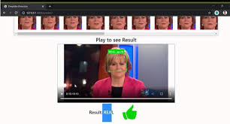
Introduction
Deepfake technology, driven by advancements in Generative Adversarial Networks (GANs), has significantly improved the ability to create highly realistic synthetic videos. These manipulated videos can alter facial expressions, voice, and movements to convincingly mimic real individuals.

Slide 7
Existing system
Several approaches have been developed to detect deepfake videos, primarily focusing on identifying inconsistencies and artifacts introduced during the synthesis process. But the lower quality videos will not be detected.
Limitations
Limited Availability of Datasets.
Struggles to detect highly realistic deepfakes videos.
Real-Time detection is difficult.

Slide 8
Proposed system
We propose a GAN-based deepfake video detection framework that leverages deep learning techniques to enhance detection accuracy and robustness.
Advantages
Improved detection Accuracy.
Large-Scale dataset collection.
Real-Time deployment.
Multi-Model Analysis.

Slide 9
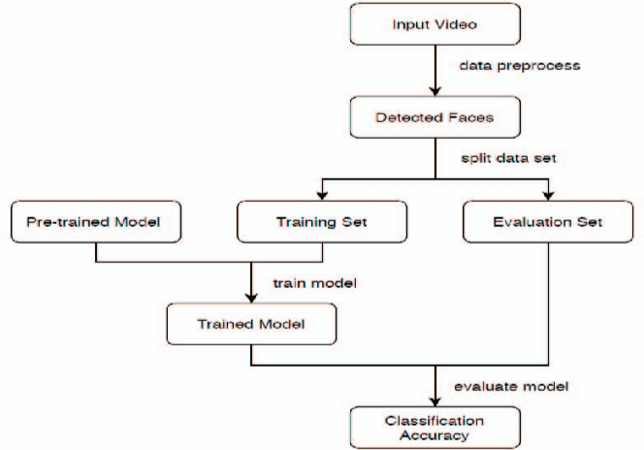
Architecture

Slide 10
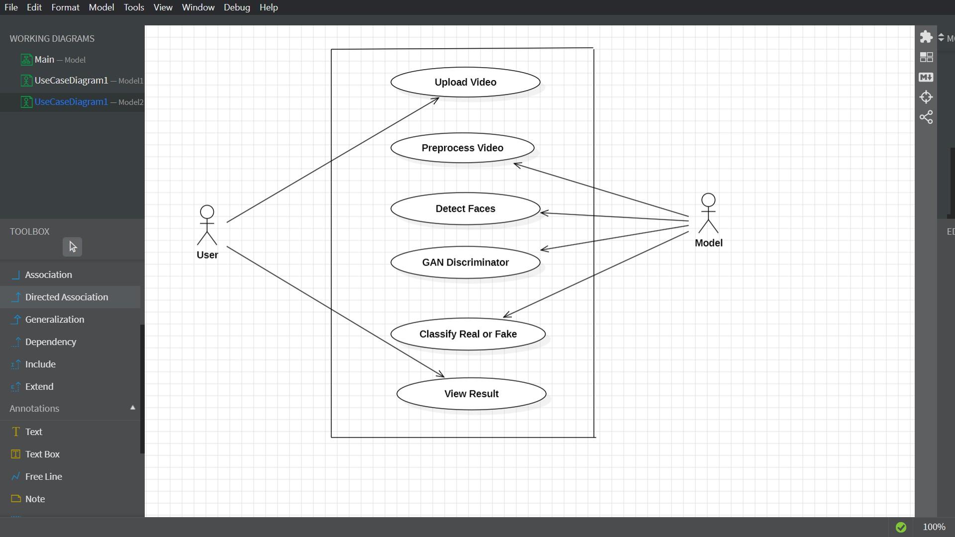
UML Diagrams
Use case

Slide 11
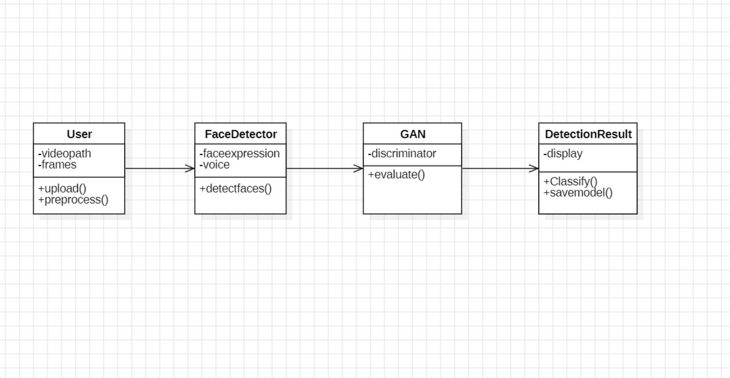
Class diagram

Slide 12
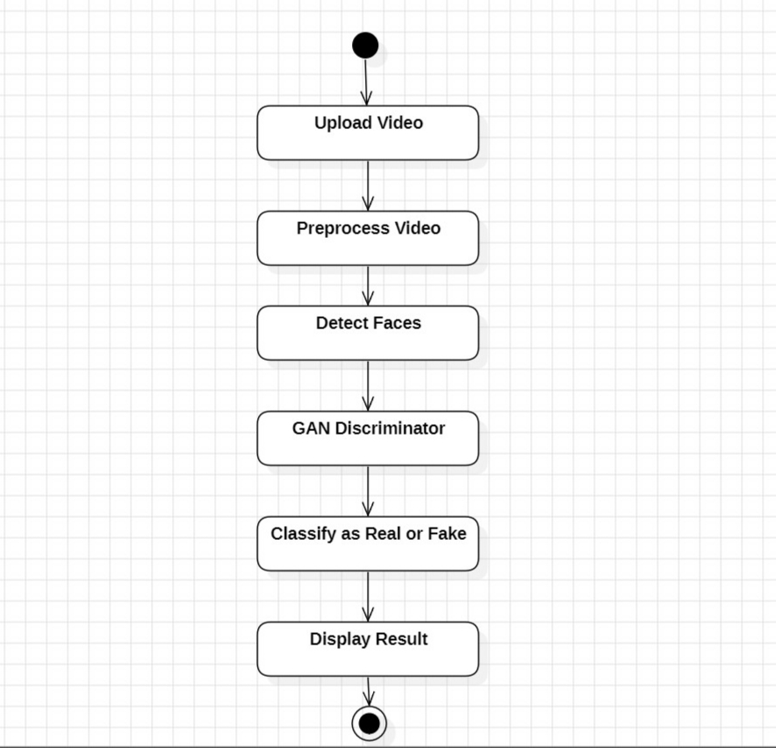
Activity diagram

Slide 13
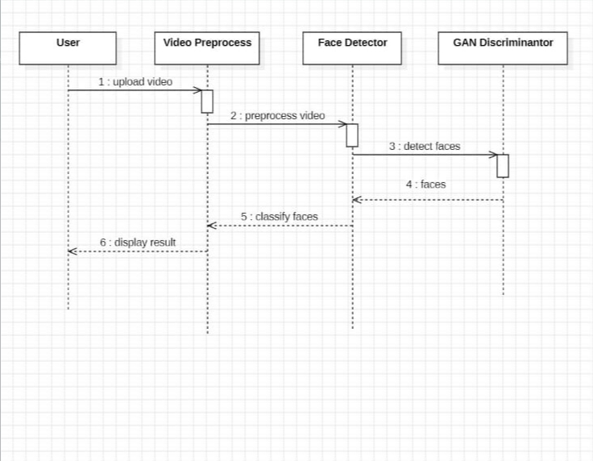
Sequence diagram

Slide 14
Literature Survey
*"Deepfake Video Detection using Convolutional Neural Networks"* by Li et al. (2020).
*"Deepfake Video Detection using RNNs"* by Kim et al. (2018) - This paper proposes a RNNs-based approach for detecting deepfake videos.
*"Deepfake Video Detection using CNN"* by Wang et al. (2017).

Slide 15
System Specification
Software requirements
Hardware requirements
Operating system: Windows 10/11.
Language : Python.
Tool : Python 3.9.
Processor : Intel Core i5 (8th Gen)
Stoarage : 256GB SSD + 1TB HDD (for dataset storage).
RAM :8GB.

Slide 16
References
Tack Hyun Jung, Sang Won Kim, and Kee Cheon Kim. Deep-Vision: Deepfakes Detection Using Human Eye Blinking Pattern. IEEE Access, 8:83144–83154, 2020.
Chan, C., Gino sar, S., Zhou, T., & Efros, A. A. (2019). In Proceedings of the IEEE/CVF International Conference on Computer Vision (pp. 5933-5942).

Slide 17
Implementation
1. Data collection.
2. Data pre-processing.
3. GAN Model Training.
4. Deployment.
5. Model Evaluation.
a)Modules

Slide 18
b)Sample code
@st.cache_resource
def load(): m = Model(); m.load_state_dict(torch.load("model/df_model.pt", map_location='cpu')); return m
def predict(path, model):
t = transforms.Compose([transforms.ToPILImage(), transforms.Resize((112,112)), transforms.ToTensor(), transforms.Normalize([0.485,0.456,0.406],[0.229,0.224,0.225])])
cap, frames = cv2.VideoCapture(path), []
while len(frames) < 20 and cap.isOpened():
r,f = cap.read(); # read frame
if not r: break
faces = face_recognition.face_locations(f)
if faces: top,right,bottom,left = faces[0]; frames.append(t(f([top:bottom,left:right]))
return ("Real" or Fake");
St.title(“deepfake detection”)
file=st.file_uploader(“Upload video”,type=[‘mp4”])
import streamlit as st, torch, cv2, face_recognition
from torchvision import models, transforms; from torch import nn; from torch.nn.functional import softmax
class Model(nn.Module):
def __init__(self): super().__init__()
m = models.resnext50_32x4d(pretrained=True)
self.f = nn.Sequential(*list(m.childr)")
en())[:-2])
self.pool = nn.AdaptiveAvgPool2d(1)
self.lstm = nn.LSTM(2048, 2048, batch_first=True)
self.fc = nn.Linear(2048, 2)
def forward(self, x): b,t,c,h,w = x.shape
x = self.pool(self.f(x.view(-1,c,h,w))).view(b,t,-1); x,_ = self.lstm(x)
return self.fc(x[:,-1])

Slide 19
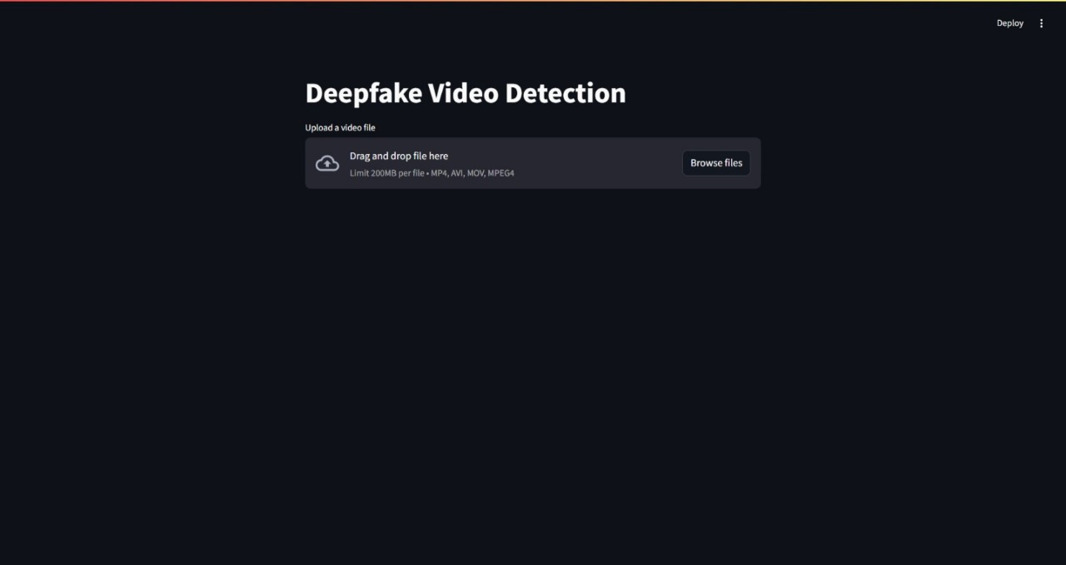
Output Screenshots

Slide 20
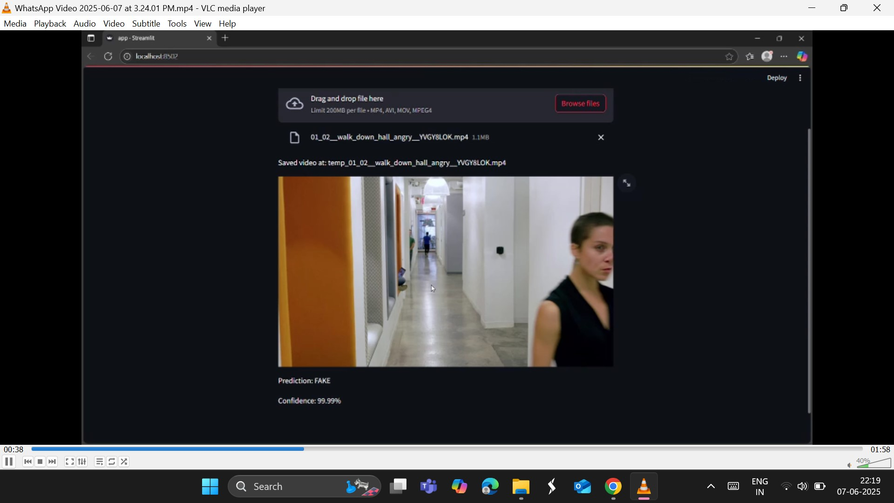

Slide 21
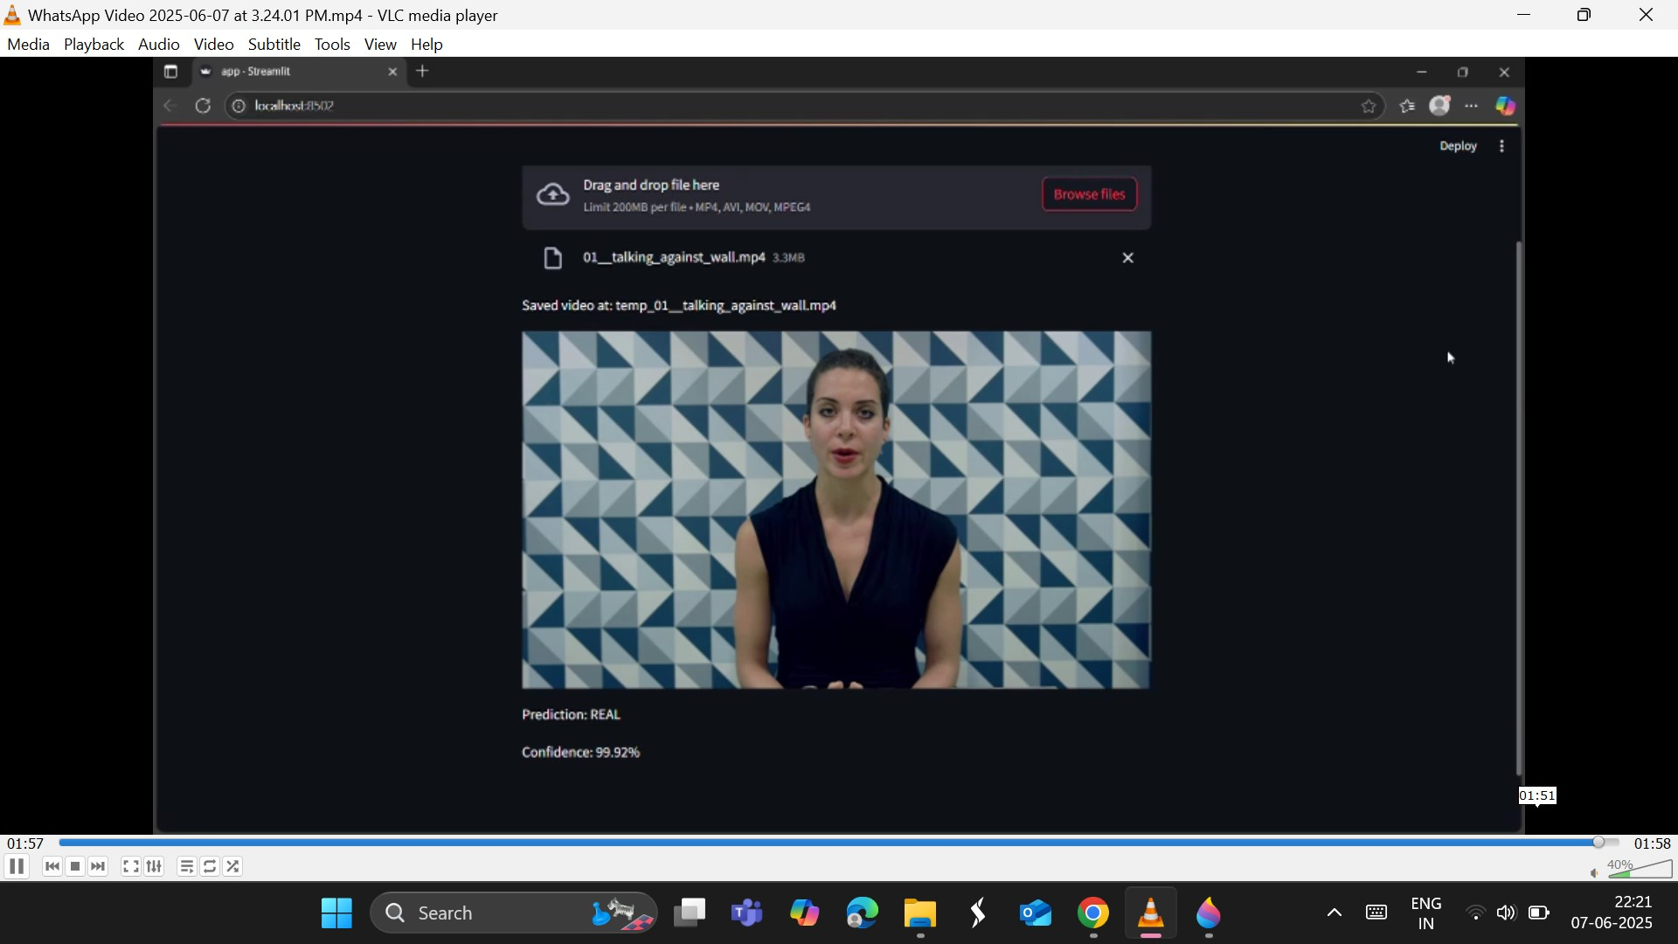

Slide 22
Testing
Integration testing.
Multi-stream GAN Models.
Attention-based GAN Models.
Artifacts Detection.

Slide 23
Future scope
Developing deepfake detection models for healthcare applications to detect and prevent medical misinformation.Integrating deepfake detection models with social media platforms to automatically detect deepfakes.Developing mobile apps that can detect deepfakes in real-time.

Slide 24
Conclusion
Deepfake videos are becoming more advanced, making it harder to tell real from fake. GANs help detect deepfakes by analyzing tiny details like unnatural facial movements, lighting issues, and hidden patterns that humans might miss. In our project, we proposed a novel approach to detect deepfake videos using GANs.

Slide 25
BIBLIOGRAPHY
[1]Yuezun Li, Ming-Ching Chang and Siwei Lyu “ExposingAI Created Fake Videos by Detecting Eye Blinking” in arxiv.
[2] HuyH. Nguyen ,JunichiYamagishi, andIsaoEchizen “ Using capsule networks to detect forged images and videos ”.

Slide 26


Slide 27


